Slide 1


MSDS 6306: Doing Data Science - Case Study 01
By
Adeel Qureshi Darryl Dawkins Scott Englerth

Slide 2
EDA Findings
California and Colorado have the highest count of breweries in the United States.
ABV has few NA’s in the dataset. The large missing values are with IBU that has 1005 missing observations. We took the simplified approach in addressing this concern.
The ABV vs IBU our machine learning model KNN was able to reach an accuracy of 85%. We found that beer style “Ale” were the higher in both IBU and ABV.
The most popular name was “American” in the beer styles. Which we found during geographical analysis of the region and text analytics.

Slide 3
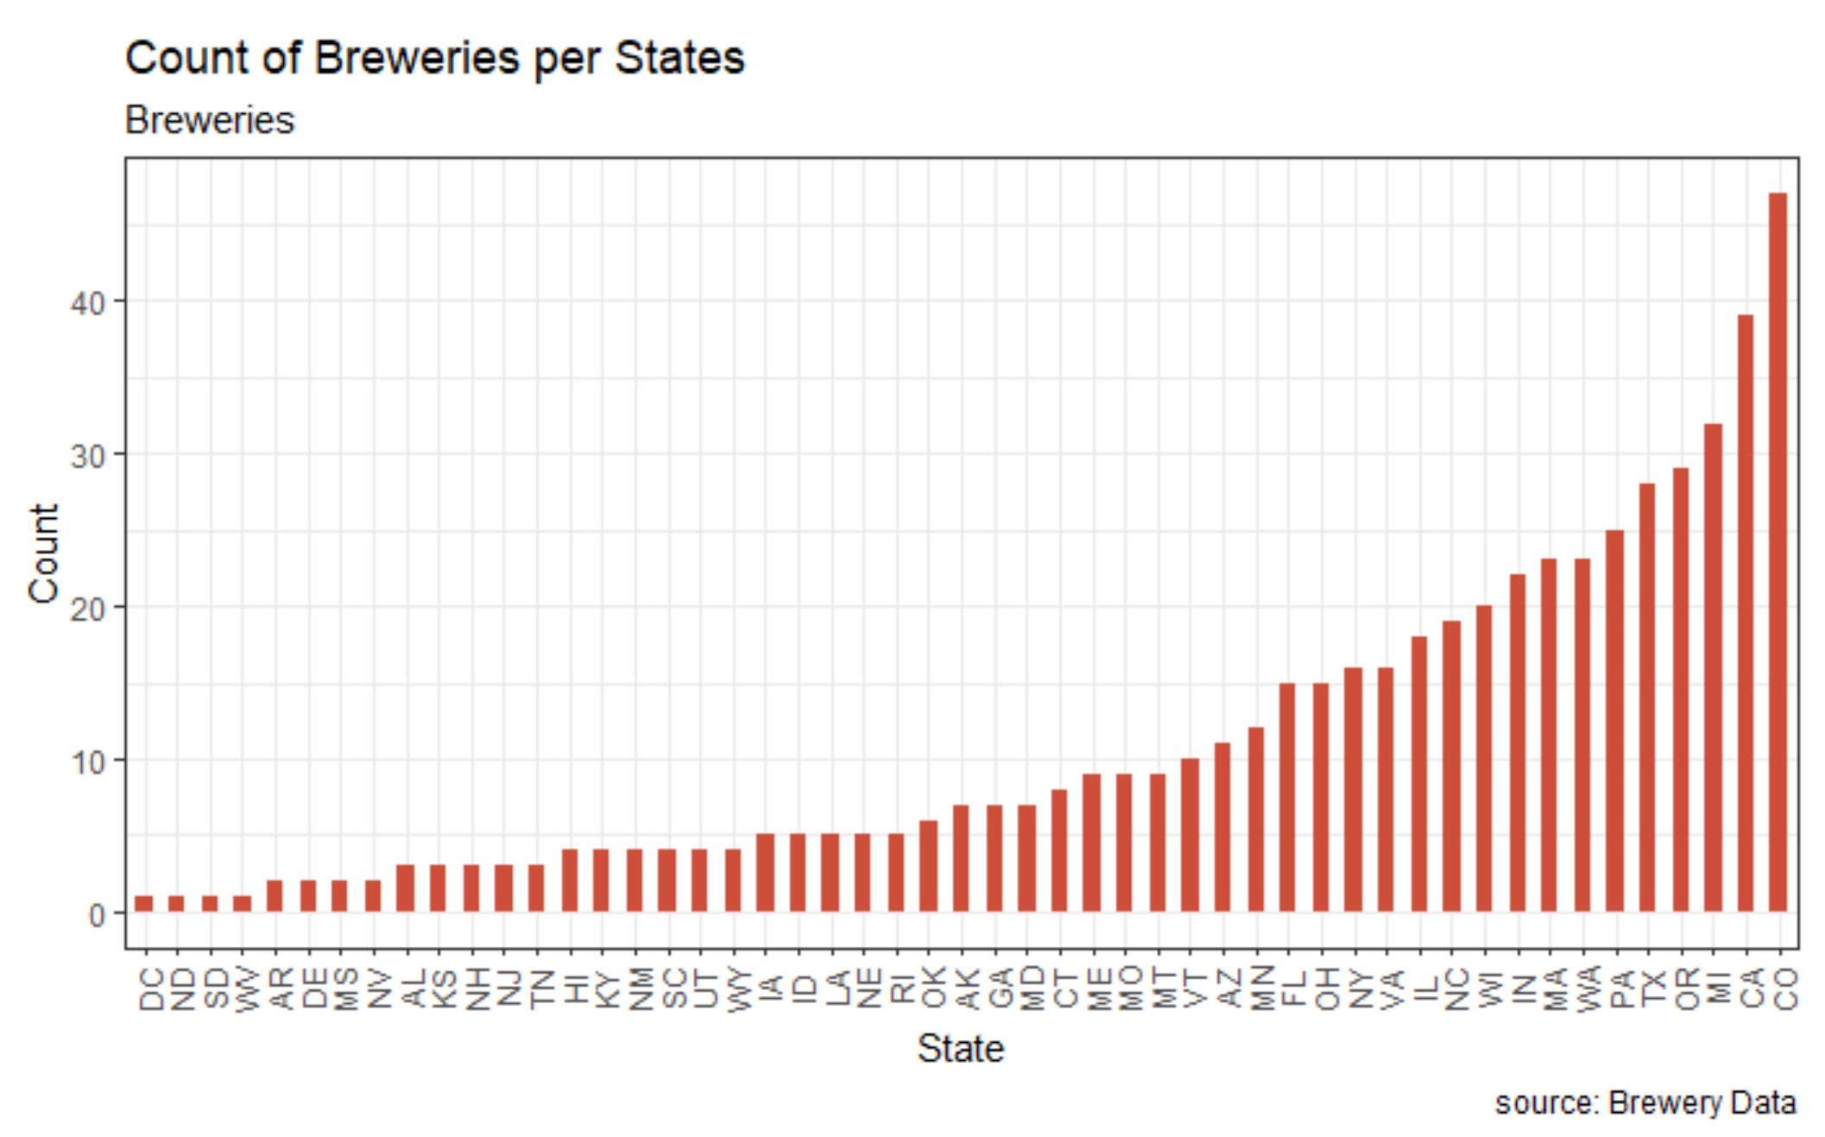
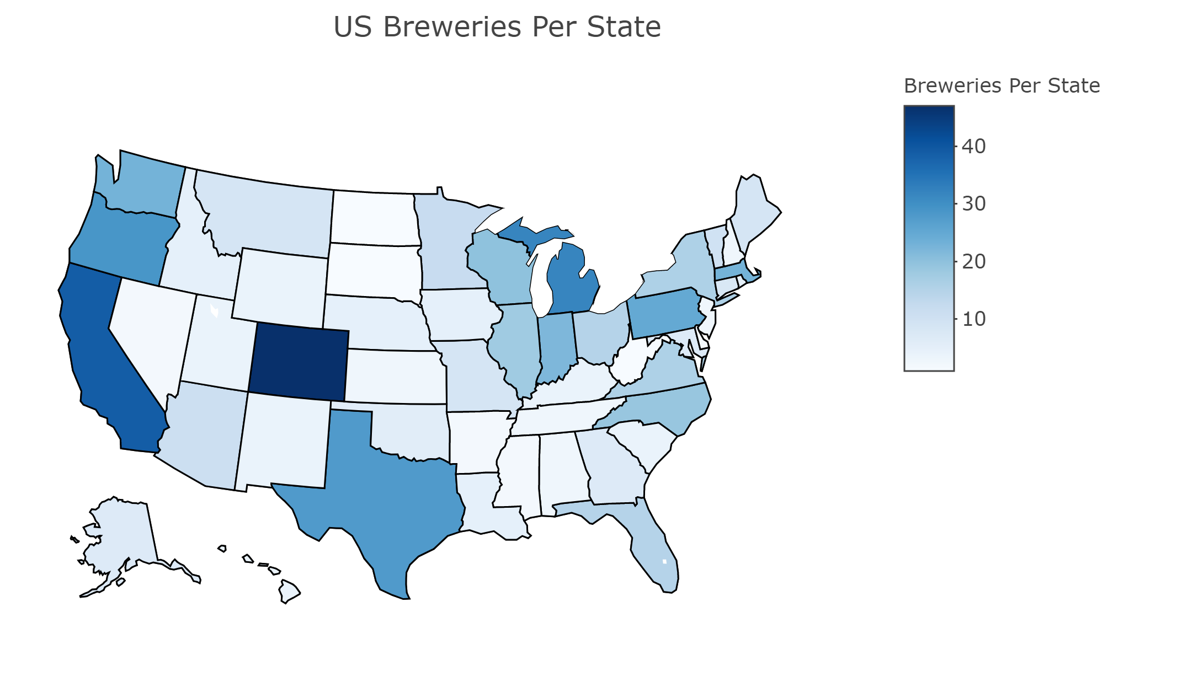
Concentration of Breweries Per State

Slide 5
Address Missing values
There are 1005 missing IBU values, 62 missing ABV values, and 5 missing Style values. All rows missing the Style were also missing the IBU. We did not make any changes tot he missing values.
Due to the large number of missing values, we analyzed a few different solutions such as median, mean or linear relationship but ultimately decided to leave them as missing data points for relevant analysis.

Slide 6
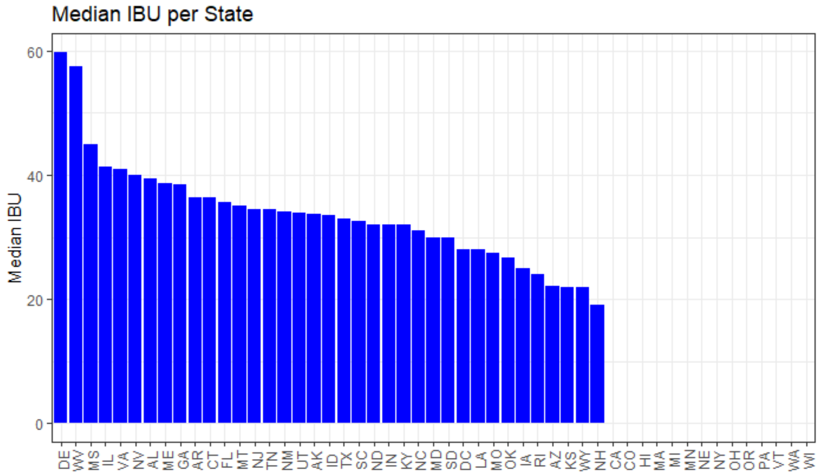
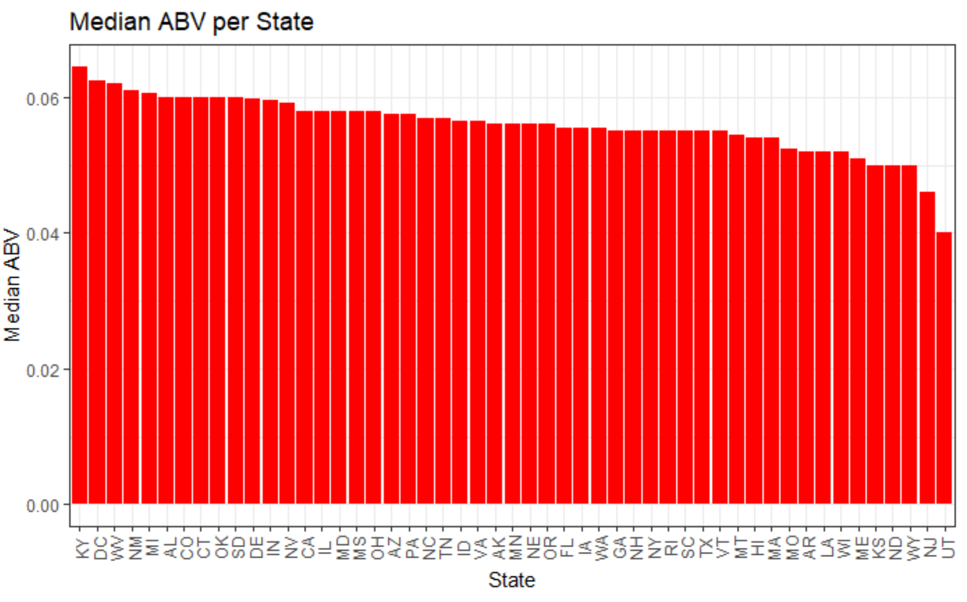
Median IBU & ABV
Delaware (61 IBU), West Virginia (57.5 IBU), Massachusetts, and Illinois (both 55 IBU) have the highest median IBU out of all the states. Arizona (20.5 IBU), Kansas (20 IBU) and New Hempshire (19 IBU) have the lowest median IBUs. DC and Kentucky (both 6.25% ABV) have the highest median ABV out of all the states. New Jersey (4.6% ABV) and Utah (4% ABV) have the lowest median ABVs.

Slide 7


Max Beer Statistics by State
The state with the max IBU is Colorado and the states with the max ABVs Oregon.
The brewery producing the beer with the highest IBU is located in Astoria Oregon.
It is the Astoria Brewing Company and they are producing the "Bitter Bitch Imperial IPA" with an IBU of 138.
The brewery producing the beer with the highest ABV is located in Boulder Colorado.
It is the Upslope Brewing Company and they are producing the "Lee Hill Series Vol. 5 - Belgian Style Quadrupel Ale" with an ABV of 12.8%.
Max ABV State is:
Max IBU State is:

Slide 8
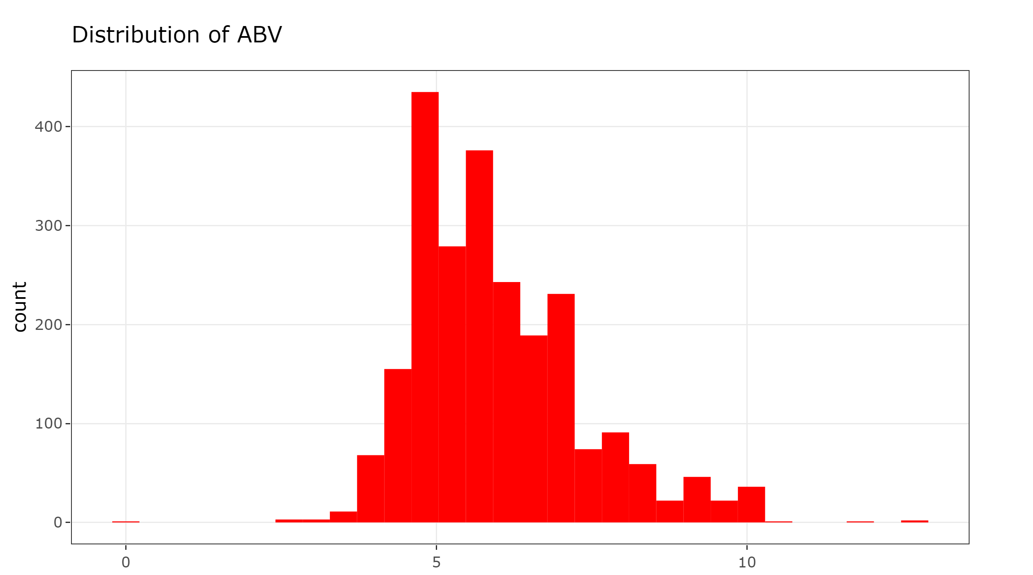
Summary Statistics of Beer
The beer brewed at the most breweries is the "Nonstop Hef Hop". 75% of beers have an ABV between 5.0% and 6.7%. 75% of beers have an IBU between 21 and 64.
The most popular styles of beer are the American IPA, the American Pale Ale and the American Amber/ Red Ale.
The brewery brewing the most beers is the "Brewery Vivant" with 62 different beers.
The city brewing the most beers is Grand Rapis, brewing 66 different beers.
Colorado is the state brewing the most beers with 265 different beers.

Slide 9
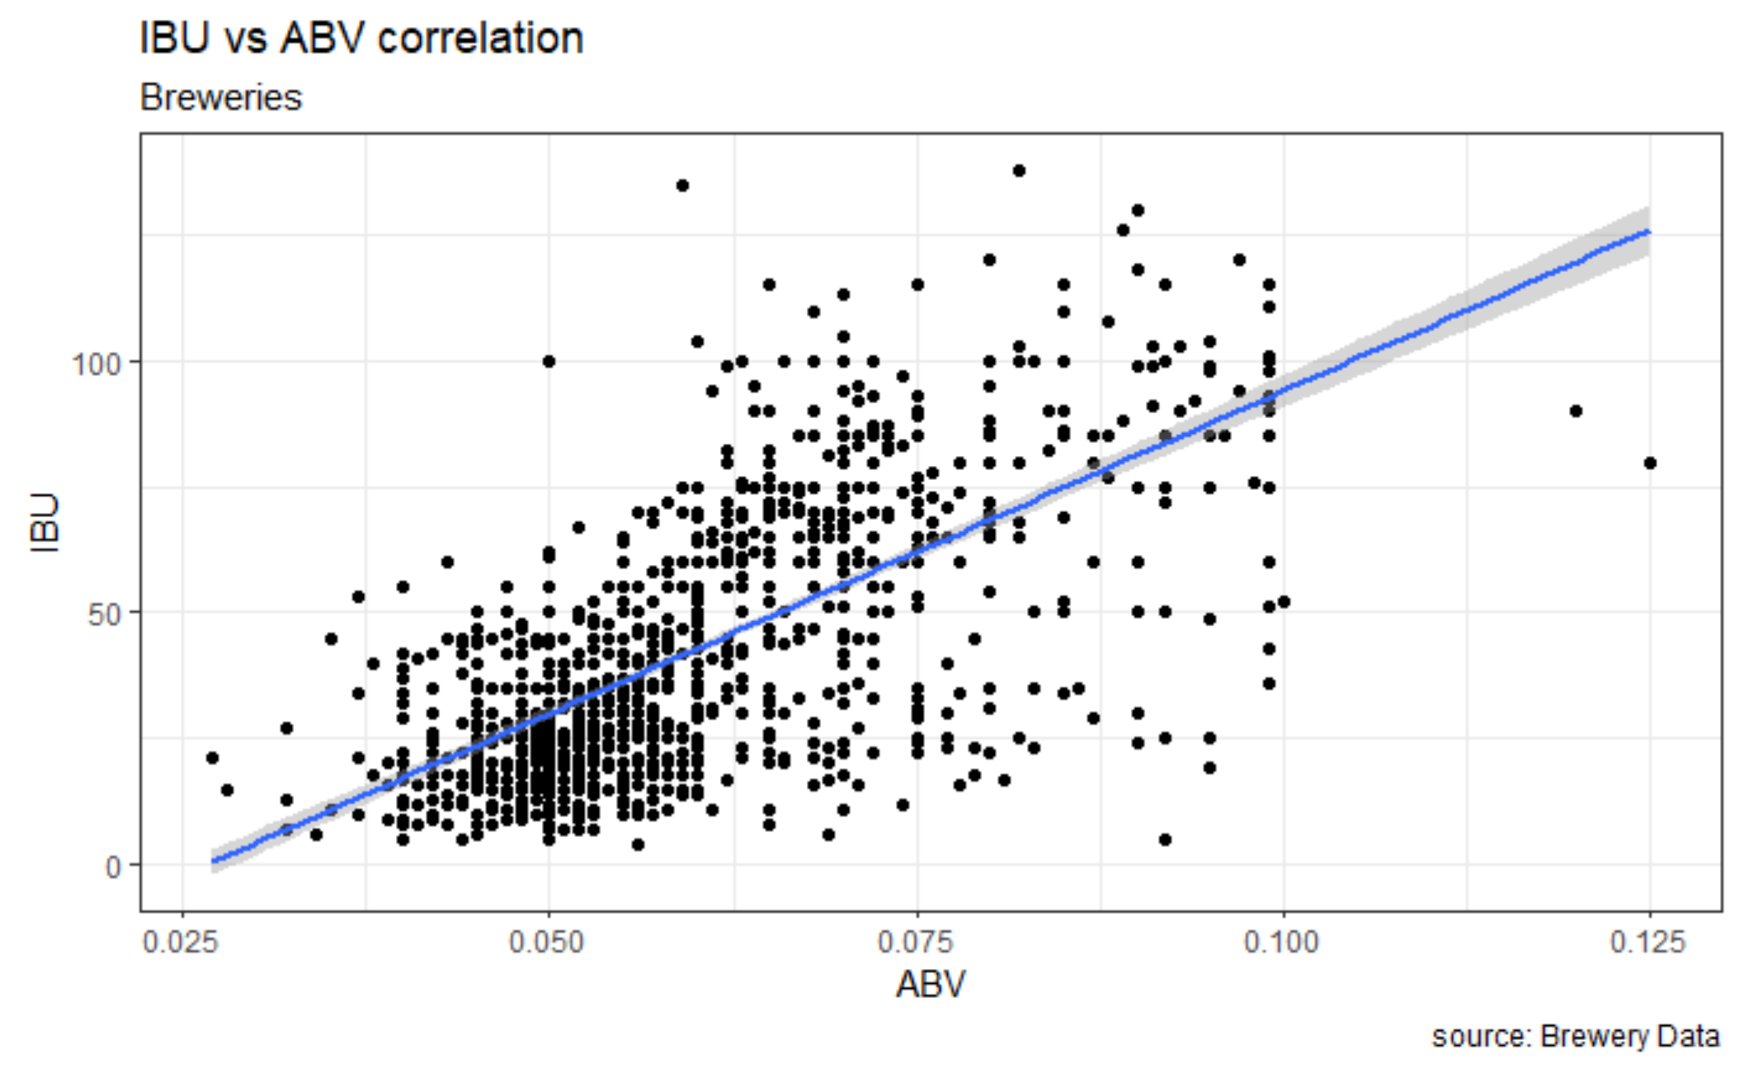
IBU vs ABV correlation
Based on the scatterplot we can visually see a linear positive relationship between ABV and IBU. This is confirmed by running a linear regression analysis on it. The R-squared value is 44.97%, p-value (<2.2e-16) and the 95% confidence interval of the slope is [1207.77, 1356.31].

Slide 10
ABV vs IBU – IPA vs Other ALE Investigation
Machine Learning Model | Accuracy | Sensitivity | Specificity
Internal k3 CV KNN | 86.0% | 87.7% | 83.4%
Internal k7 CV KNN | 85.9% | 88.4% | 82.1%
Internal k11 CV KNN | 84.4% | 87.1% | 80.1%
Naïve Bayes | 84%
KNN Machine Learning Model ran in various settings can predict the style of each beer with ~85% accuracy
Alternatively our Naïve Bayes model can predict the the style of the beer with 84% accuracy
Models are run only on ABV and IBU
Model accuracy will likely improve as we feed it more complete data or additional differentiating data points

Slide 11
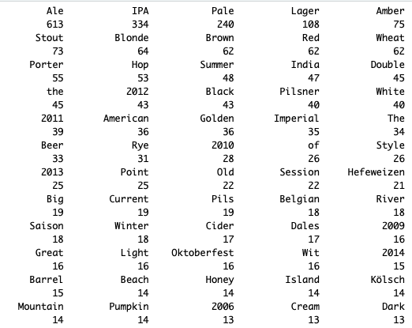
Popular Beer Names
Top 5 most popular words in beer names in the United States:
Ale 613
IPA 334
Pale 240
Lager 108
Amber 75

Slide 12
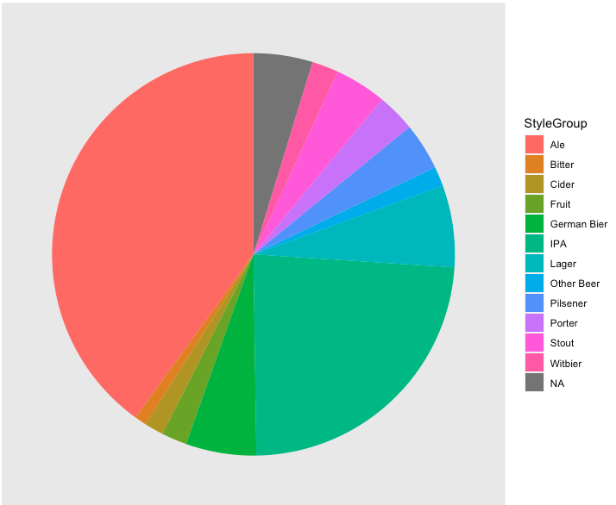
Beers grouped by Style
We can categorize 95% of the data set into 12 major style categories through text recognition.
This summarizes the 100+ different styles into a the major groups for further analysis and strategic planning.

Slide 13
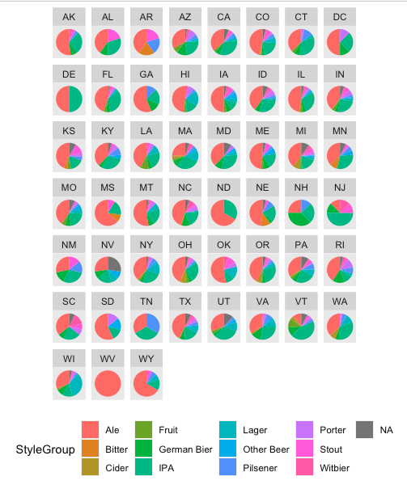
Popular Styles by state

Slide 14
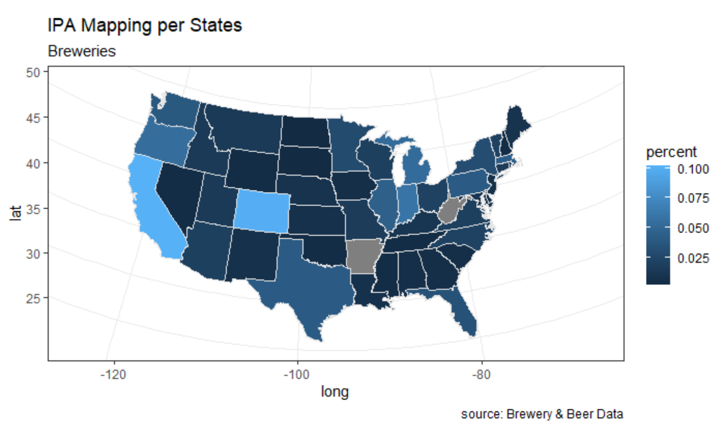
Regions to launch next product
Best region to launch is Southeast area from Louisiana and to Georgia. The area’s preference is towards lower ABV and IBU for products. There is lower concentration for IPA in the southeast region would be opportunity to explore the market.

Slide 15
Final recommendations
We recommend after thoroughly analyzing the data, that southeast market has great potential for launching a new Budweiser IPA. The markets we identified were Louisiana, Mississippi, Alabama, and Georgia.
Areas we recommend stating away from is West Coast due to high concentration breweries and matured market. The States like Georgia and surrounding states have had growth in population due to lower cost of living. This Southeastern area that identified has lower count of breweries in the region compared states like Texas, Colorado and California.

